Slide 1

Bivariate analysis: Simple regression
Investigation & Report

Slide 2
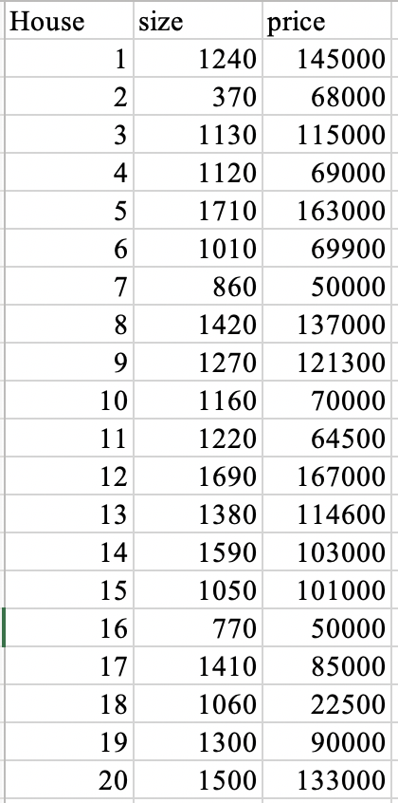
Analyze the relationship between two ratio-level variables

Slide 3
Scattergram
Relationship between two continuous variables can be portrayed on a scattergram (scatterplot)
By convention the dependent variable is shown on the vertical axis (Y) and the independent variable on the horizontal axis (X)
Each dot on the scattergram represents a case in the sample

Slide 4
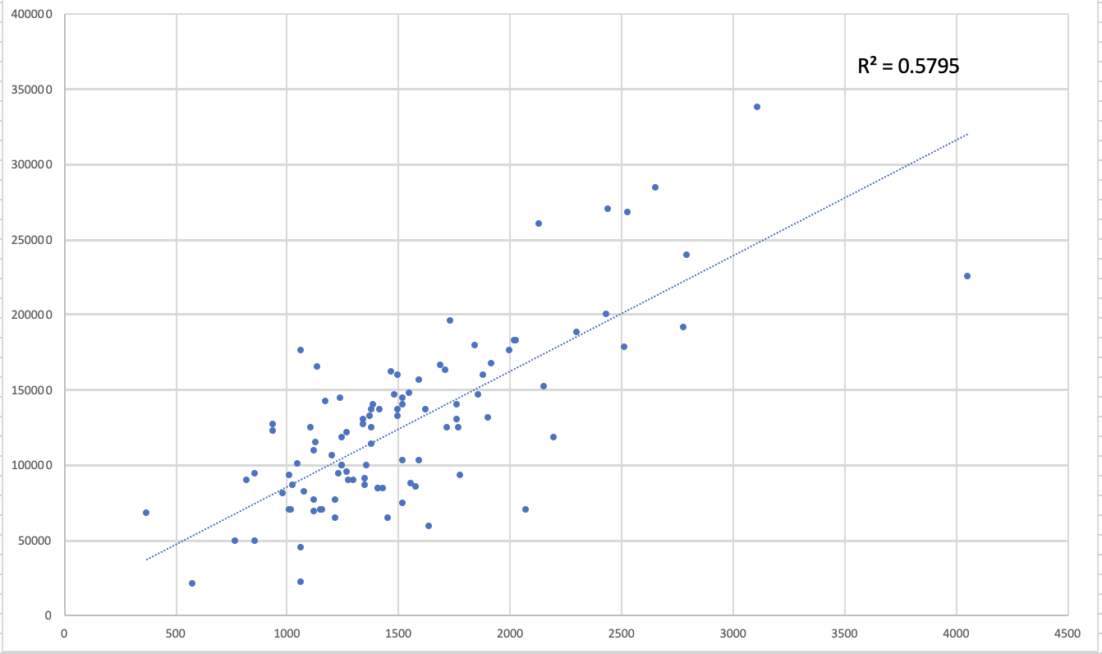

Slide 5
Scattergram
These graphs allow us to quickly identify some important features of the relationship
The clarity of the pattern of the dots can be enhanced by drawing a straight line (regression line) through the cluster of dots
The strength of the association can be judged by observing the spread of the dots around the line: The more the dots are clustered around the line, the stronger the association between the variables
The direction of the relationship (positive or negative) can be detected by observing the angle of the line

